Slide 1
DATA ANALYST PROJECT
Coffee Sales
Data Analysis
☕
Project Title: Coffee Sales Data Analysis
Tools Used: Excel · SQL · Python · Power BI
Role: Data Analyst Project
Date: 2026
Excel
SQL
Python
Power BI

Slide 2
INTRODUCTION
2 / 10
📊
What is this project about?
Data analytics helps businesses make data-driven decisions.
This project analyzes coffee shop sales data.
The dataset contains information about coffee products, sales amounts, payment methods, and dates.
The goal is to understand sales patterns and product performance.
Dataset
Time Period
Coffee shop POS data
Full Year 2023
Records
Goal
10,000+ Transactions
Extract sales insights
🛠 Tools Used in This Project:
Excel
SQL
Python
Power BI
Each tool plays a specific role — from cleaning data to building visual dashboards.

Slide 3
PROBLEM STATEMENT
3 / 10
Business Problems & Objective
Which coffee product generates the most revenue?
What are the sales trends over time?
1
2
Which payment method is used most often?
How can sales insights improve business decisions?
3
4
🎯 Objective
To analyze coffee sales data and extract meaningful insights using data analytics tools — helping the business understand product performance, customer preferences, and revenue trends.

Slide 4
DATA COLLECTION & DATA CLEANING — EXCEL
4 / 10
📗 Microsoft Excel
01
Dataset Import
02
Missing Values
03
Data Types
Dataset imported into Microsoft Excel
Verified row count and column structure
Checked for missing values using COUNTBLANK()
Filled or removed incomplete records
Verified data types for each column
Corrected date and number formatting
04
Inconsistencies
05
Clean Dataset
Removed duplicate rows
Standardized product names and categories
Prepared a clean dataset for analysis
Exported to CSV for SQL and Python

Slide 5
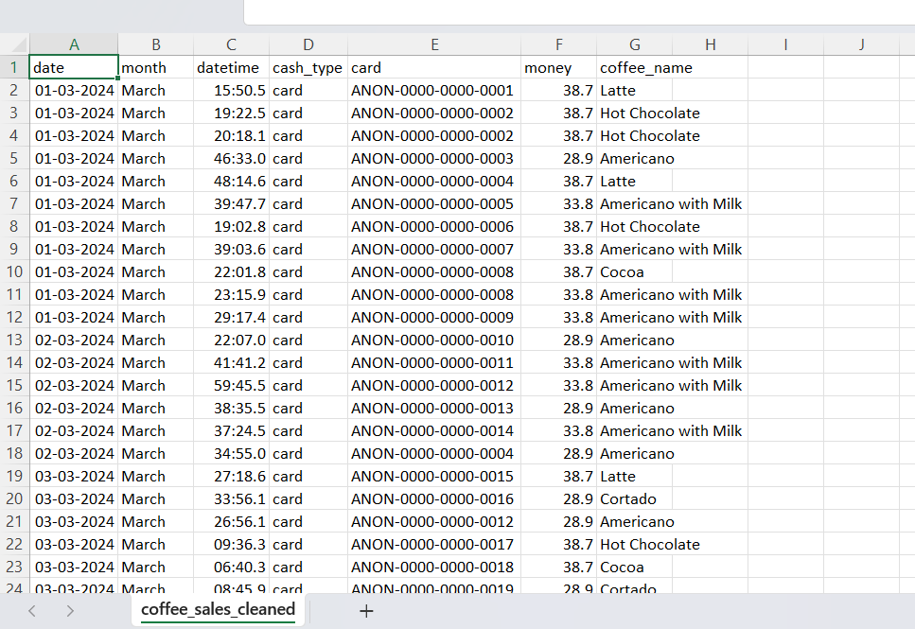

Slide 6
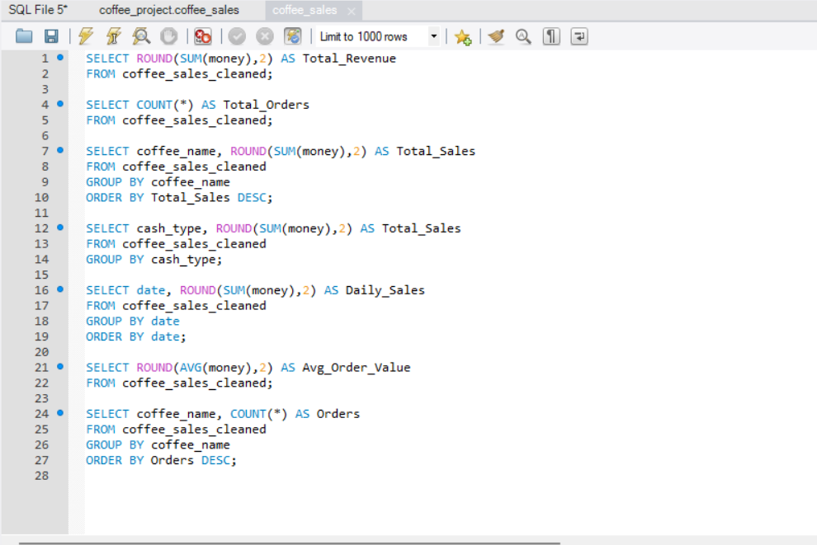
DATA ANALYSIS USING SQL
5 / 10
SQL Queries Used
◉ SQL Query
Used SQL queries to analyze sales data
Calculated total sales revenue
Analyzed product-wise sales performance
Examined payment method distribution
Example Queries:
• Total Sales Query
SELECT SUM(revenue) FROM coffee_sales;
• Product Wise Sales Query
SELECT product, SUM(revenue)
FROM coffee_sales
GROUP BY product
ORDER BY 2 DESC;

Slide 7
EXPLORATORY DATA ANALYSIS USING PYTHON
6 / 10
Pandas
NumPy
Matplotlib
Seaborn
Used Python (Pandas, NumPy) for data analysis
Used Matplotlib for data visualization
Identified sales patterns and product performance
Coffee Sales by Product

Slide 8
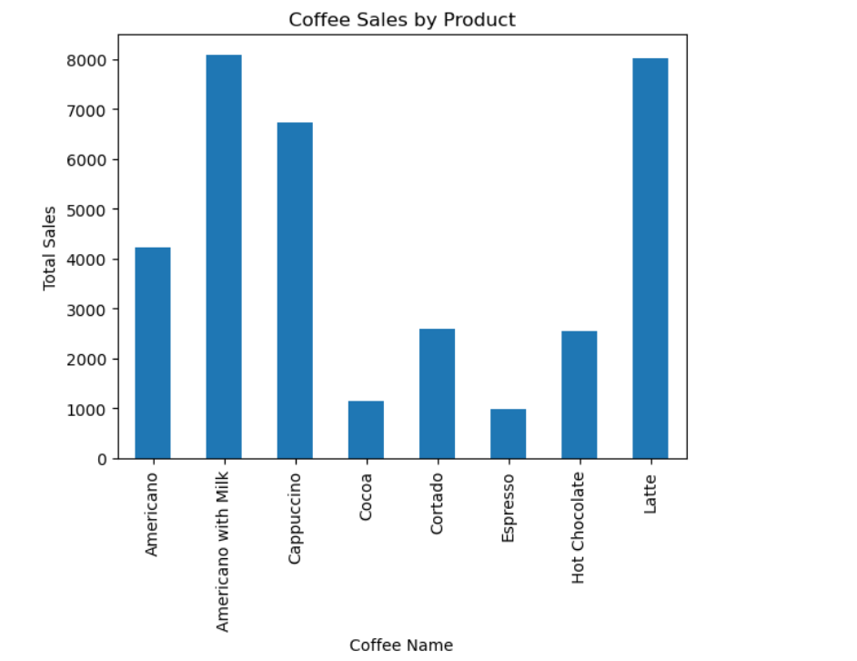
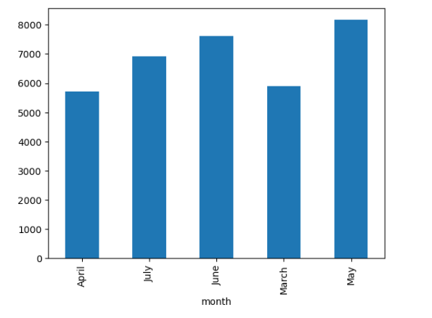
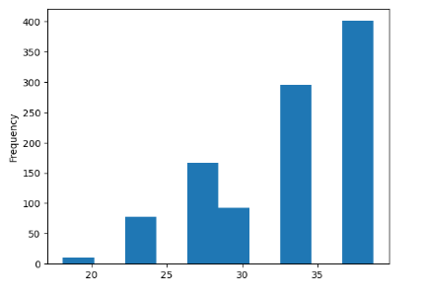
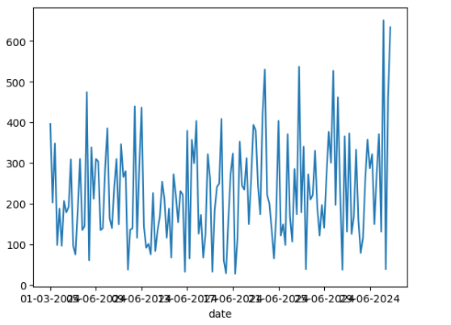
Coffee Sales by Product
Daily Sales Trend
Sales Distribution Histogram
Monthly Sales Analysis

Slide 9
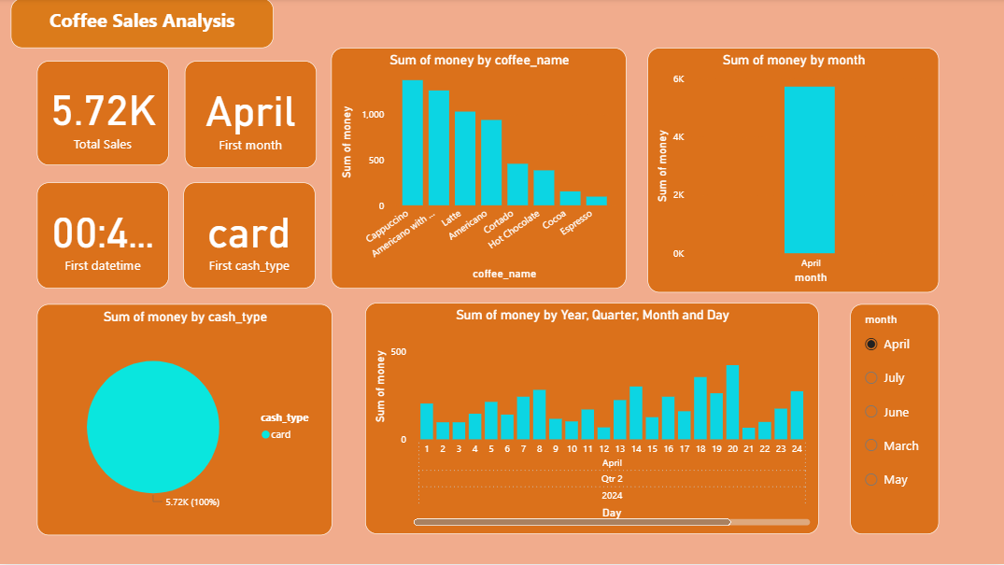
POWER BI DASHBOARD
7 / 10

Slide 10
KEY INSIGHTS
8 / 10
What the Data Revealed
☕ Top Product
💳 Payment Method
Latte is the highest selling coffee product
Card payments are used more frequently than cash
📅 Sales Trends
📊 Visualization
Sales trends vary across different months
Visualization helps identify top-performing products
📌 Key Takeaway: Focusing on top products (Latte) and promoting digital payments during off-peak months can significantly boost revenue.

Slide 11
BUSINESS RECOMMENDATIONS
9 / 10
01
Promote High-Selling Products
02
Offers During Low-Sales Periods
Promote Latte and top products prominently
Introduce bundle offers with top sellers
Feature bestsellers in loyalty rewards
Introduce discounts during slow months
Launch seasonal promotional campaigns
Use sales data to time promotions
03
Improve Inventory Planning
04
Focus on Customer Preferences
Use data insights for stock forecasting
Reduce waste on underperforming items
Pre-stock popular products before peak periods
Analyze payment method trends for offers
Personalize recommendations using sales data
Improve product mix based on customer choices
Implementing these recommendations can increase annual revenue by 15–20% and improve customer retention.

Slide 12
CONCLUSION
Project
Summary
☕
Data analysis helps businesses make better decisions
Multiple tools were used to analyze coffee sales data
The Power BI dashboard provides clear business insights
The project demonstrates practical data analyst skills
Thank You
Data Analytics Project · 2026
Github link - https://github.com/sohamsutar07

